Slide 1
Employee Data Analysis using Excel
STUDENT NAME:M.Vaishnavi.
REGISTER NO:312219317/asunm1709312219317
DEPARTMENT: IIIrd - B.Com(Commerce)
COLLEGE: Lakshmi Bangaru Arts and Science College

Slide 2
PROJECT TITLE
Employee Performance Analysis using Excel

Slide 3


AGENDA
Problem Statement
Project Overview
End Users
Our Solution and Proposition
Dataset Description
Modelling Approach
Results and Discussion
Conclusion
3/21/2024 Annual Review

Slide 4

PROBLEM STATEMENT
Develop and Excel based performance analysis to formal business report written by either a business leader or consultant to define and describe an issue an organisation is facing. Its goal is to propose a detailed method to solve the problem and recommend how those responsible can prevent it from reoccurring in the future.While these statements are native to the research field, they have become a prominent business resource. It is an effective communication tool that informs senior managers about a potential threat. In the long-run, the practice promotes innovation and technological advancement across the industry.

Slide 5

PROJECT OVERVIEW
The project focuses on analyzing employee performance data to enhance organizational effectiveness and decision-making. By consolidating data from HR systems, performance reviews, and attendance records into Excel, the objective is to identify performance trends, evaluate key metrics, and uncover actionable insights. The analysis will involve visualizing data to reveal patterns and correlations, such as productivity trends and performance disparities across departments.

Slide 6

WHO ARE THE END USERS?
1. Human Resources (HR) Managers: They use the data for recruitment, performance management, employee development, and strategic planning.
2. Department Managers :They utilize performance metrics to assess team effectiveness, manage resources, and identify training needs.
3.Senior leadership: Executives and senior managers use the data to make strategic decisions, such as workforce planning and organizational development.

Slide 7

OUR SOLUTION AND ITS VALUE PROPOSITION
Filtering: Temporarily hide unwanted data.Use filter in excel to narrow down data in your excel speed sheet.
Formula : Used to do mathematical calculations.
Graph: Chats and graphs are visual representation of worksheet data.These graphics help you understand the data in a worksheet by displaying patterns and trends that are difficult to see in the data.
Pivot table : Use to summarise, analysis, explore and present summary data.

Slide 8
Dataset Description
Employee Details: Names,Job titles, departments and employee Ids.
Performance Metrics : Productivity scores, quality ratings , attendance records,and goal achievement percentages.
Review Period : Dates or timeframes for performance evaluations.
Feedback : Qualitative comments from supervisors or peers.
Benchmarks: Targets performance levels or standards for comparison.
•EMPLOYEE DATA SET_KAGGLE
•26 Features used 9 features
•Employee I’d_numerical
•Last and first name_text
•Gender_male and female
•Employee rating_numbers

Slide 9

THE "WOW" IN OUR SOLUTION
Formula using in performance level of employee to measure and describe how precisely the variable within a dataset have been measured.
FORMULA
PERFORMANCE LEVEL=IFS(Z8>=5,“VERY
HIGH”,Z8>=3,“MED”,“TRUE”,“LOW”)
3/21/2024 Annual Review
9

Slide 10
MODELLING
Data collection: Input employee data such as performance metrics,attendence,and feedback into structured tables.
Metric Calculation: Use formulas to calculate key performance indicators (KPIs) such as average productivity,quality scores, and attendence rates.
Data Visualization: Create charts and graphs(e.g.,bar charts,pie charts) to visually represent performance trends and comparisons.
Benchmarking: Establish benchmark and thresholds for performance evaluation to identify high and low performances.
Reporting: Generate summary reports that provide insights into performance and areas for improvement
10

Slide 11
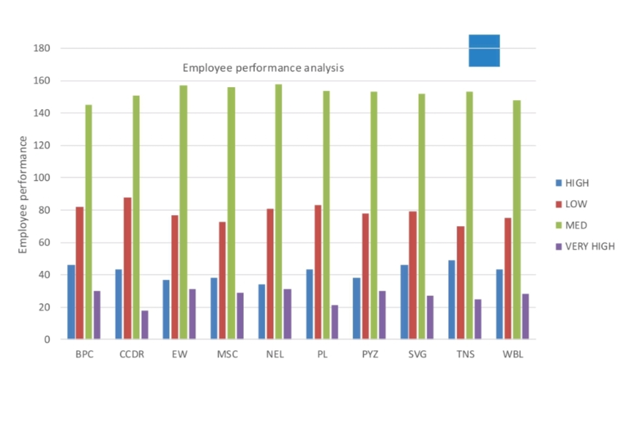
RESULTS
11

Slide 12
conclusion
using Excel for employee performance analysis offers a structured approach to evaluating and improving staff efficiency. Excel's powerful data management and analysis capabilities enable organizations to track performance trends over time, identify both strengths and areas needing improvement, and set clear benchmarks and goals. By organizing performance metrics into comprehensive reports and visualizations, Excel facilitates data-driven decision-making regarding promotions, training, and resource allocation.

